Slide 1
Financial - Analysis: CTSH
Team 3
Amit Sharma, 0794488
Suhail Ahmed, 0789949
Rajvi Mehta, 0788372
Harshil Patel, 0791261
Jayraj Radadiya, 0789984

Slide 2
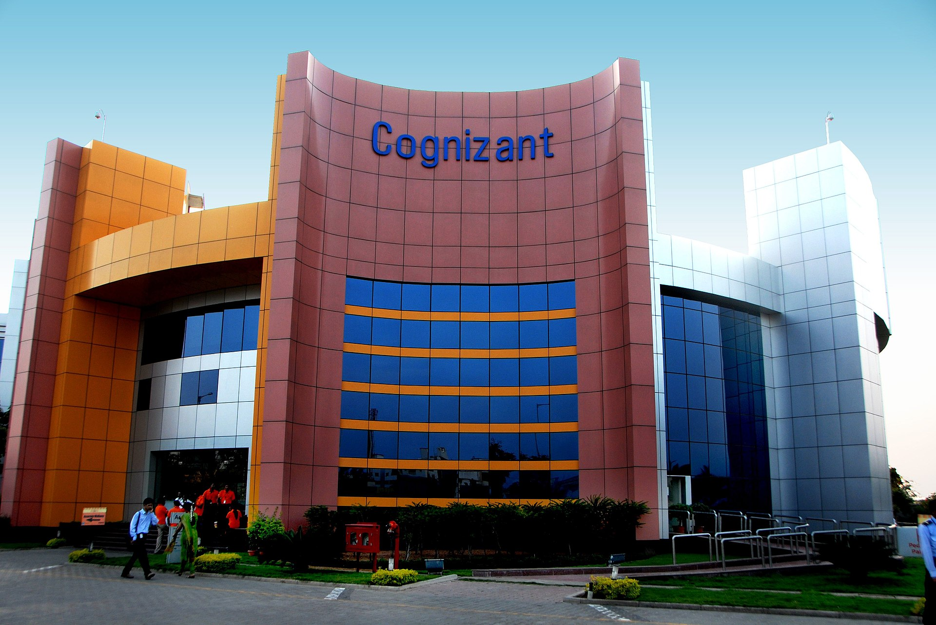

Goal
The goal is to predict the future performance of a stock using a combination of financial models and analysis techniques such as Capital Asset Pricing Model (CAPM), Dividend Growth Model, Facebook Prophet, Bollinger Bands, Financial Ratios, and Monte Carlo Analysis.
The objective is to estimate the expected return and level of risk associated with the stock based on various market factors and historical data. The purpose of this analysis is to assist investors in making informed decisions about whether to buy, hold, or sell the stock.

Slide 3
Cognizant Technology Solutions - CTSH
Employees worldwide
Total revenue
2022 Fortune 500 ranking
355,300
$19.4B
#194
Cognizant Technology Solutions was founded in 1994 in the United States and initially focused on providing technology development and support services to its clients. The company grew rapidly in the late 1990s and early 2000s, expanding its operations to India in 1996 and becoming a public company in 1998 when it was listed on the NASDAQ stock exchange. Over the years, Cognizant has expanded its service offerings to include digital, technology, consulting, and operations services. The company has a global workforce of over 300,000 employees, serving clients in more than 40 countries. In recent years, Cognizant has been investing heavily in innovation and expanding its digital capabilities to better serve its clients in the evolving digital landscape. (Source: Cognizant.com)
1
2
The current macroeconomic environment and business cycle are favorable for Cognizant's business. The global economy is recovering from the COVID-19 pandemic, and the business cycle is in the expansion phase, leading to increased demand for digital transformation and technology services. Cognizant's ability to adapt and innovate has been key to its success in this challenging environment. (Source: McKinsey & Company)
The IT industry environment is highly competitive, with numerous players competing for market share. Some of Cognizant's top competitors include Accenture, Tata Consultancy Services, IBM, Infosys, and Wipro. As of 2021, Cognizant had a market share of approximately 4.6%, trailing behind Accenture and TCS, which had market shares of 9.4% and 8.6%, respectively, according to Statista. (Source: Statista)
3

Slide 4
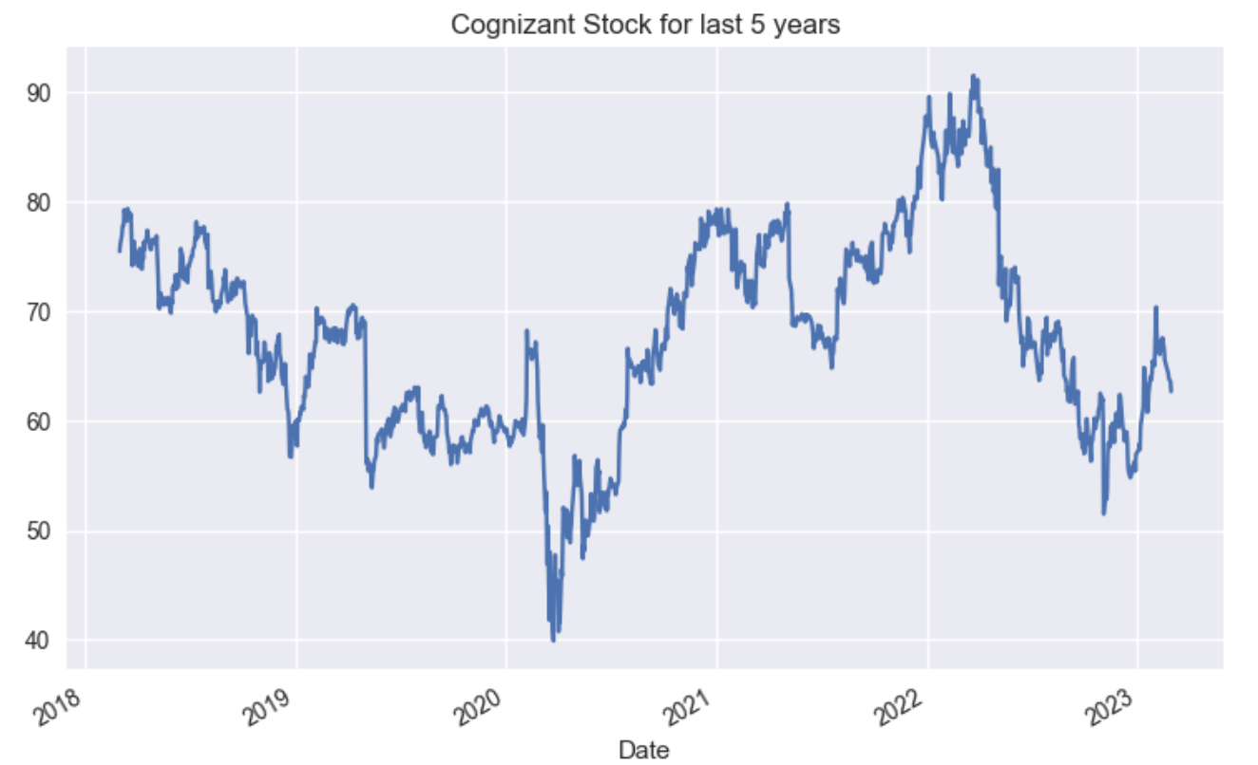
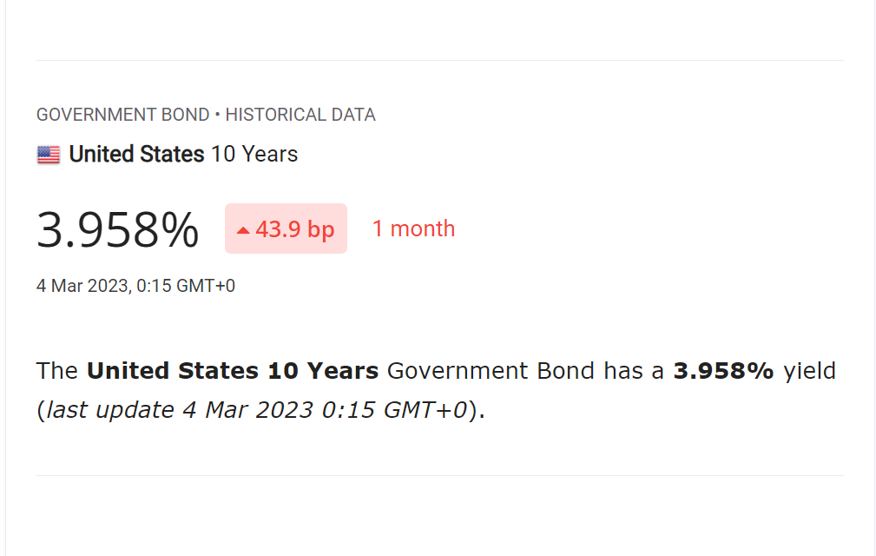
Cognizant (CTSH) – Valuation - CAPM & Dividend Growth
CAPM
Using the CAPM, value of r (the expected return on the asset) comes out as 9.417%; with a calculated Beta value as 1.1035 (Yahoo value for Beta is 1.11 as on 7/4/2023).
r = rf + β(rm - rf)
Dividend Growth Model
Expected return on asset (r) = 9.417%
Earnings Per Share = $ 4.42
Payout Ratio = 24.67%
Dividend per share(DS)=Earnings per Share*Payout Ratio=$ 1.089
Dividend growth rate (g) = 7.9%
Value = $ 71.715
Value = DS / (r - g)
Dividend Growth Model is used to estimate the intrinsic value of a stock based on its dividends.
A 9.417% growth rate is considered moderate to high rate of growth, it is generally seen as a positive sign for investors, as it suggests that the company is performing well and has a good outlook for the future.

Slide 5
Ratios
Liquidity ratios:
Liquidity is the amount of cash and easily-convertible-to-cash assets a company owns to manage its short-term debt obligations; Liquidity is a key factor in assessing a company's basic financial health. Before a company can prosper in the long term, it must first be able to survive in the short term
Current Ratio: 2.17 – Industry between 1.5 and 3, CTSH is well placed here
Quick Ratio: 1.42 – have cash assets to pay current liabilities, CTSH is well placed here
Cash Ratio: 1.40 – CTSH being service industry have minimal inventory so very similar Quick and Cash ratios, CTSH is well placed here
1
Profitability ratios:
Profitability ratios are a class of financial metrics that are used to assess a business's ability to generate earnings relative to its revenue, operating costs, balance sheet assets, or shareholders' equity over time, using data from a specific point in time. They are among the most popular metrics used in financial analysis.
Gross Profit Margin: 35.93%- Market Range of less than 50% is considered Bad, CTSH is not doing good here
Operating profit margin: 15.28% - Range for industry is 5 to 20%, CTSH is well placed here
2

Slide 6
Ratios - Contd…
Profitability ratios:
Return on assets: 12.83% - ROA of over 5% is generally considered good, CTSH is well placed here.
Return on equity: 18.60% - anything over 15% is generally seen as good. (13.63 to 19.68.), CTSH is well placed here
Return on sales: 15% - Better than 82% of the companies in the sector, CTSH is well placed here
Return on Investment: 18.40%- between 10% to 20% is considered to be a good range, CTSH is well placed here.
Other Important ratios:
Debt to Equity Ratio: 5.35% - debt to equity ratio up to 50% is considered good, CTSH is well placed here.
Price to Earning Ratios : 14.01- A P/E ratio of less than 15 is generally considered excellent, CTSH is well placed here.
Dividend payout ratio: 25.80% - A dividend payout ratio of less than 30% is generally considered good, CTSH is well placed here
Growth Rate: 4.98%- A growth rate of less than 5% is generally considered bad, CTSH is just on the border for this year * (average for last 5 year is 6.09%)
3

Slide 7
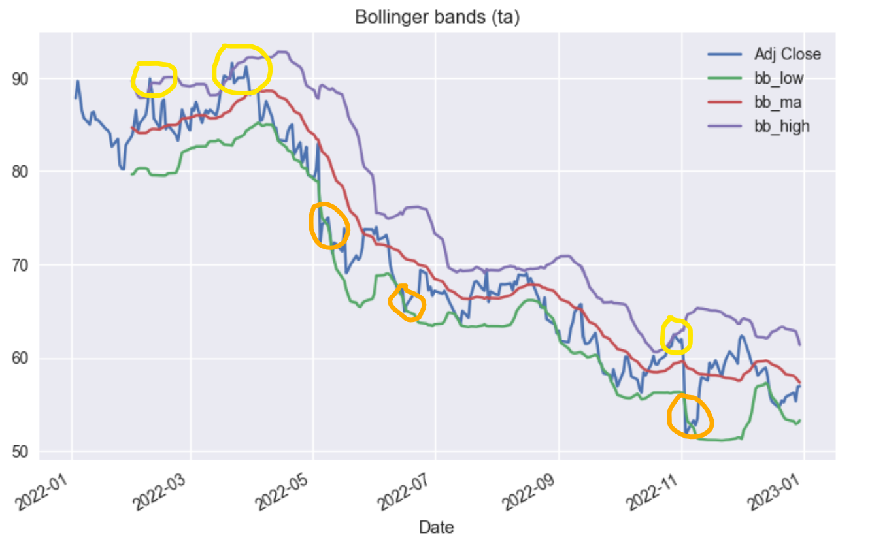
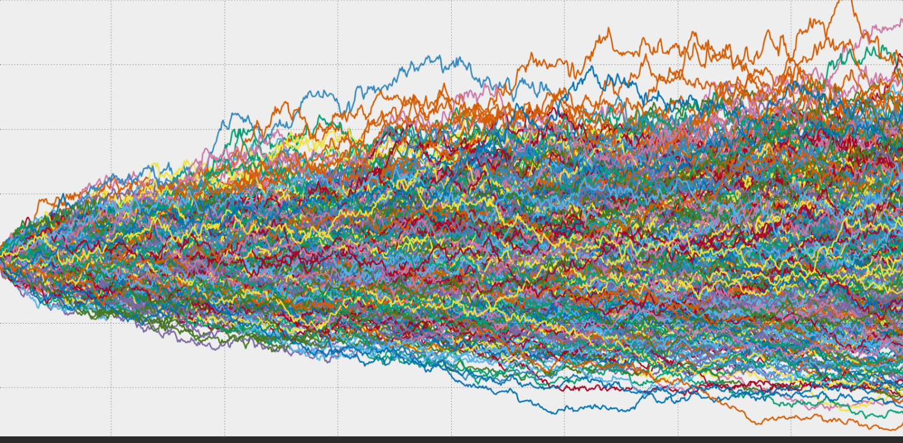
Technical Analysis & Monte Carlo Simulation
Monte Carlo
Montecarlo simulation done from January 01,2022 through December 31, 2022, and simulated the stock price for January 1,2023 through December 31, 2023; by performing 10,000 simulations
Average Price: $ 56.85
Standard Deviation: 1.2560
Average Return : -0.16%
positive returns: 46.8%
Bollinger Bands
Bollinger Bands identify potential overbought or oversold conditions. When the price of a stock moves above the upper band (Yellow circles), it is considered overbought, and when it moves below the lower band (Orange circles) , it is considered oversold. Investors may use this information to help identify potential trading opportunities, such as selling when the price reaches the upper band and buying when it reaches the lower band. Bollinger Bands also help investors identify potential trend reversals. If the price of a stock is trending up, and it touches or breaks below the lower band, this may signal a potential trend reversal.

Slide 8
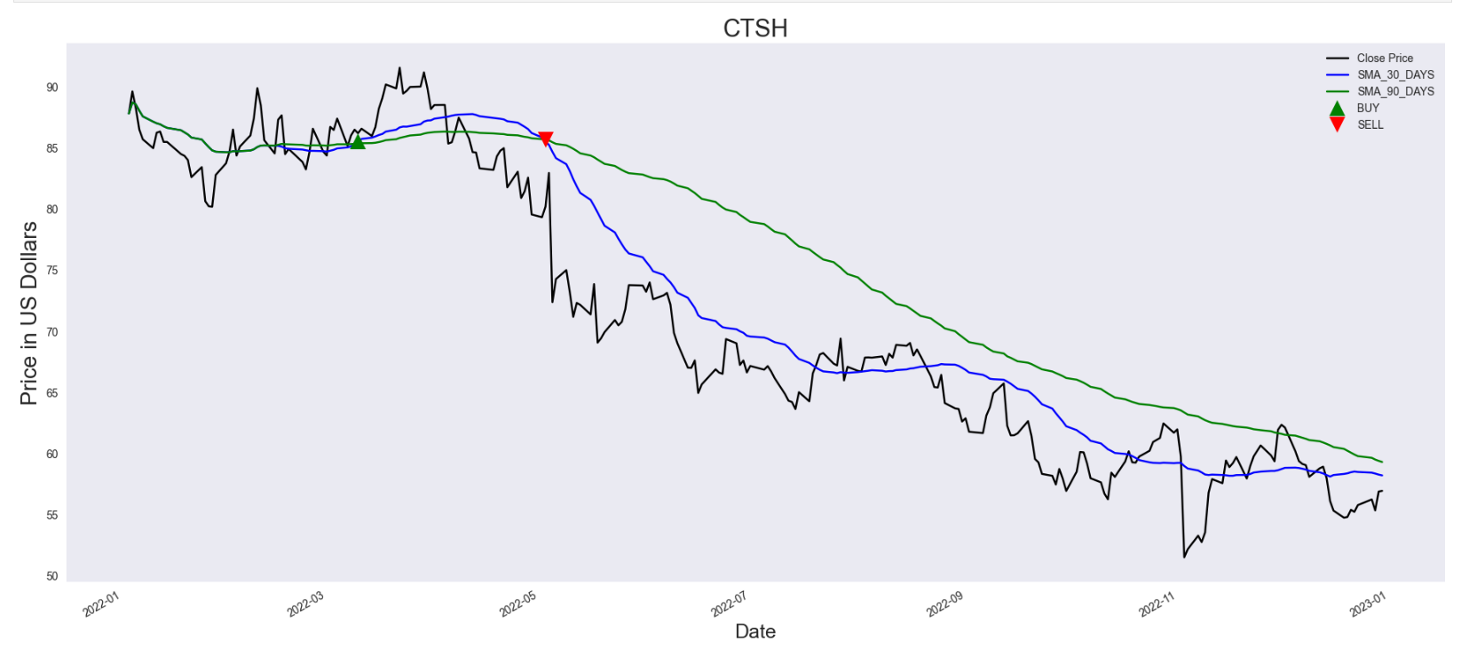
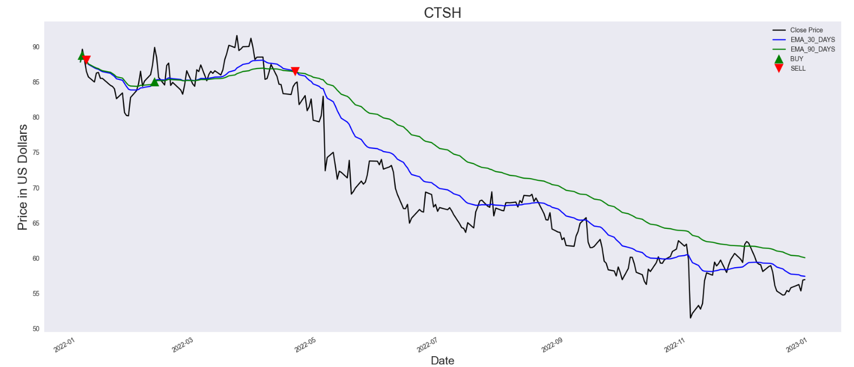
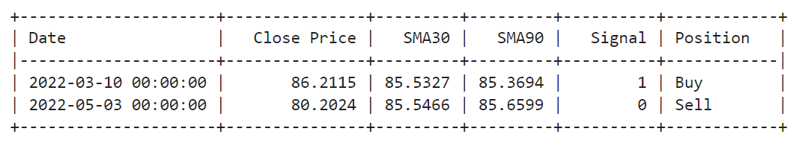
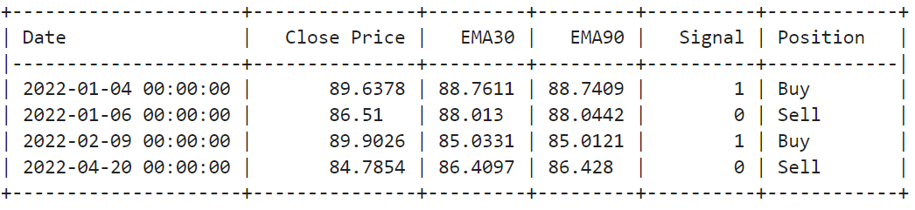
Stock Signals
Support and Resistance Levels: The MA can also be used to identify support and resistance levels. When the price of a stock is trading above its 30-day SMA, the MA can act as a support level. Similarly, when the price is trading below its 30-day MA, the MA can act as a resistance level. The 90-day MA can provide a stronger indication of support and resistance levels.
Crossovers: The Moving average can generate buy and sell signals based on crossovers. A crossover occurs when the shorter-term MA (30-day) crosses above or below the longer-term MA (90-day). A bullish crossover occurs when the 30-day MA crosses above the 90-day MA, indicating a potential buy signal. Conversely, a bearish crossover occurs when the 30-day MA crosses below the 90-day MA.

Slide 9
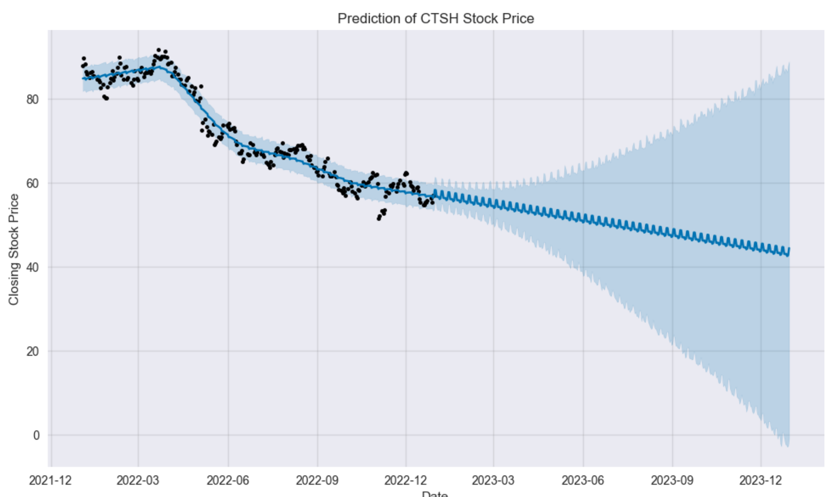
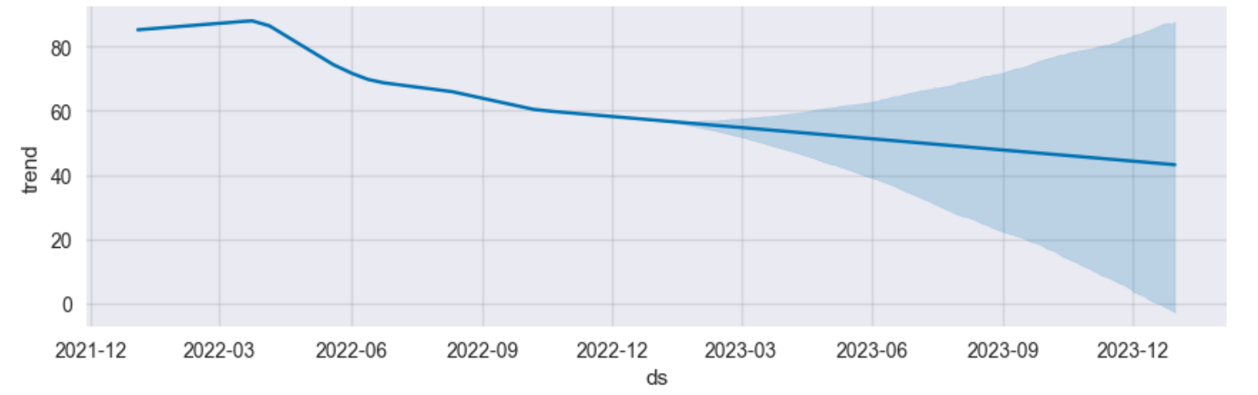
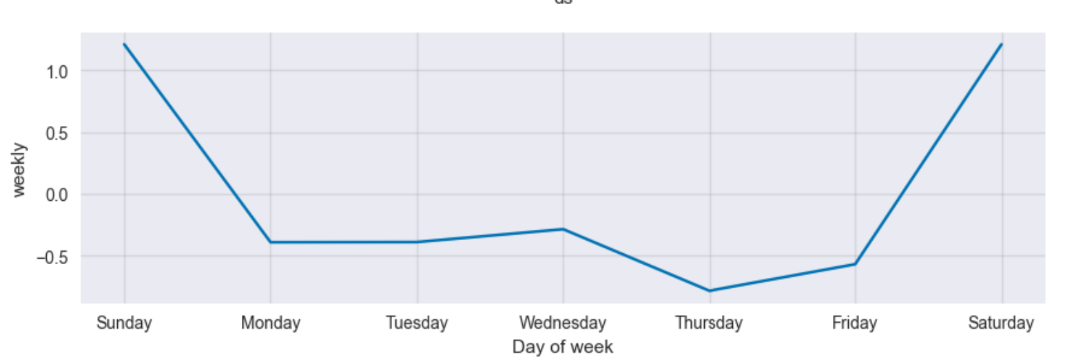
Forecasting – Fb Prophet
Facebook Prophet is a time series forecasting library developed by Facebook's data science team. It can be used to forecast future trends and patterns in time series data, including stock prices. Here's how it can help in stock prediction:
Handling Seasonality
Flexibility
Visualization
Interpretability
Prophet forecast a gradual Decline in the Stock price.
This is considering the current Market position and recent decline in
CTSH stock price over last year. Also seasonality is there at a weekly
Basis but its negative.

Slide 10
Recommendation
Our analysis recommends a "HOLD" position for CTSH stock currently, recent Market recession and company restructuring has affected CTSH growth. CTSH has undergone managerial changes of late which has impacted some growth rate. CTSH has given consistent 9% returns over the years and has strong financials and principles so wait until market conditions stabilize is suggested if you plan to buy CTSH stock as company's strong financials and principles provide a solid foundation for future growth
Current market conditions also suggest a "HOLD" position until conditions stabilize
Market Recommendation online for CTSH:
The average analyst rating for CTSH stock from 34 stock analysts is "Hold". This means that analysts believe this stock is likely to perform similarly to the overall market. According to 34 stock analysts, the average 12-month stock price forecast for CTSH stock is $66.7, which predicts an increase of 10.39%. The lowest target is $49.49 and the highest is $95.55. On average, analysts' rate CTSH stock as a hold. (Source: Statista)

Slide 11

References
https://www.cognizant.com/us/en/about-cognizant
https://www.cognizant.com/en_us/about/documents/q4-2022-corporate-overview.pdf
https://www.cognizant.com/en_us/about/documents/q4-2022-corporate-factsheet.pdf
https://seekingalpha.com/article/3784566-cognizant-dominant-player-in-booming-software-service-industry
https://comparable-companies.com/search?domain=https://www.cognizant.com
https://www.nasdaq.com/market-activity/stocks/ctsh/dividend-history
https://corporatefinanceinstitute.com/resources/valuation/dividend-growth-rate/
https://stockanalysis.com/stocks/ctsh/forecast/
http://www.worldgovernmentbonds.com/bond-historical-data/united-states/10-years/

Slide 12
Thank you.

